Slide 1
Module 7 Guidance Notes (7.1) File I/O and Streams
ENGG1340/COMP2113 Computer Programming II/Programming Technologies

Slide 2
What are we going to learn?
C++ Streams
File streams
Output file streams
Write to file
Appending data to a file
Input file streams
Read from file
String streams
Stream output formatting
Output manipulators: showpoint, fixed, scientific, setprecision, setw, setfill, left/right

Slide 3
Streams
C++ uses a convenient abstraction called streams to perform input and output operations from/to sources/destinations of sequences of characters, e.g.,
cout is a stream object for sending output to the screen (a.k.a. standard output)
cin is a stream object for taking input from keyboard (a.k.a standard input)
C++ provides operators and manipulators to work with streams:
Operators:
>>: for extracting characters from a stream, e.g., cin >> x;
<<: for inserting characters to a stream, e.g., cout << x;
Manipulators:
these are for formatted input/output, e.g., to set the display format for a floating number

Slide 4
FILE I/O

Slide 5
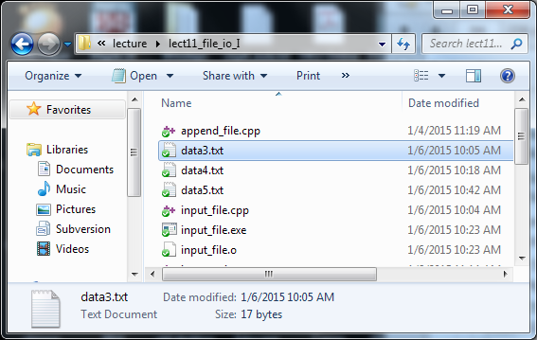
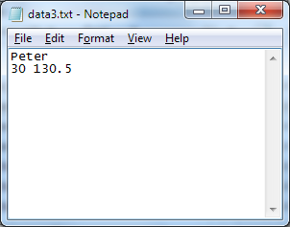
File Input/Output
Files are used for storing data permanently. The data is stored in the hard drive of your computer and you can read and write from/to it with your program.
C++ simply views a file as a sequence of bytes:
Contents of "data3.txt"
'P' | 'e' | 't' | 'e' | 'r' | '\n' | '3' | '0' | ' ' | '1' | '3' | '0' | '.' | '5' | eof
A file in the file system named "data3.txt"
end of file marker

Slide 6
File Input/Output
C++ provides two classes, namely ofstream (output stream) and ifstream (input stream), for writing and reading data to and from files
To use the classes ofstream and ifstream, simply include the header file fstream, i.e.,
#include <fstream>

Slide 7
Write to File
File I/O

Slide 8
Output File Stream
A basic example for creating and writing to a file
string name = "Peter";
int age = 30;
double weight = 130.5;
fout << name << " " << age << " "
<< weight << endl;
fout.close();
return 0;
}
#include <iostream>
#include <fstream>
#include <cstdlib>
#include <string>
using namespace std;
int main()
{
ofstream fout;
fout.open("data1.txt");
if ( fout.fail() ) {
cout << "Error in file opening!" << endl;
exit(1);
}
Include the file stream header file
Create an ofstream (output file stream) object and connect it to an external file named "data1.txt"
These two statements can be replaced by:
ofstream fout ("data1.txt");
After executing these two statements, a file will be created in your hard drive (in the same directory as your program executable):
data1.txt
output_file.cpp

Slide 9
Output File Stream
A basic example for creating and writing to a file
string name = "Peter";
int age = 30;
double weight = 130.5;
fout << name << " " << age << " "
<< weight << endl;
fout.close();
return 0;
}
#include <iostream>
#include <fstream>
#include <cstdlib>
#include <string>
using namespace std;
int main()
{
ofstream fout;
fout.open("data1.txt");
if ( fout.fail() ) {
cout << "Error in file opening!" << endl;
exit(1);
}
This if block serves to exit the program if unable to create file.
Function exit forces a program to terminate immediately, and is often used to terminate a program when an error is detected in the input or if a file to be processed by the program cannot be opened.
data1.txt
output_file.cpp

Slide 10
Output File Stream
A basic example for creating and writing to a file
string name = "Peter";
int age = 30;
double weight = 130.5;
fout << name << " " << age << " "
<< weight << endl;
fout.close();
return 0;
}
#include <iostream>
#include <fstream>
#include <cstdlib>
#include <string>
using namespace std;
int main()
{
ofstream fout;
fout.open("data1.txt");
if ( fout.fail() ) {
cout << "Error in file opening!" << endl;
exit(1);
}
Write to the file stream fout using the insertion operator << (just as what we do with cout)
Finally disconnects the file stream fout from the external file
data1.txt
Peter 30 130.5\n
eof
output_file.cpp

Slide 11
Summary Steps for Creating and Writing to a File
ofstream fout;
Declare an output stream variable.
Open the file
Check if there is any error in opening the file
Use the insertion operator << to write to file
Close the file
fout.open("data.txt");
if (fout.fail())
fout << "12345";
fout.close();
string filename = "data.txt";
fout.open(filename.c_str());
if the file name is stored as string

Slide 12
Appending Data to a File
When opening a file for output using the member function open(), a new file will be created if the file does not already exist, otherwise the content of the existing file will be erased
To keep the content of the existing file and append new data to it, supply the constant value ios::app as a second argument to the member function open(), e.g.,
fout.open("data2.txt", ios::app)

Slide 13
Appending Data to a File
string name = "John";
int age = 25;
double weight = 129.3;
fout << name << " " << age << " "
<< weight << endl;
fout.close();
return 0;
}
#include <iostream>
#include <fstream>
#include <cstdlib>
#include <string>
using namespace std;
int main()
{
ofstream fout;
fout.open("data2.txt", ios::app);
if (fout.fail()) {
cout << "Error in file opening!"
<< endl;
exit(1);
}
data2.txt (before executing the program)
Peter 30 130.5\n
eof
data2.txt (after executing the program)
Peter 30 130.5\n
John 25 129.3\n
eof
append_file.cpp

Slide 14
Read from File
File I/O

Slide 15
Input File Stream
A basic example for reading from an existing file
string name;
int age;
double weight;
fin >> name >> age >> weight;
fin.close();
cout << name << ", " << age << ", "
<< weight << endl;
return 0;
}
#include <iostream>
#include <fstream>
#include <cstdlib>
#include <string>
using namespace std;
int main()
{
char filename[80] = "data3.txt";
ifstream fin;
fin.open(filename);
if ( fin.fail() ){
cout << "Error in file opening!"
<< endl;
exit(1);
}
Include the file stream header file
Create an ifstream (input file stream) object and connect it to an external file named "data3.txt"
These few statements can be replaced by:
ifstream fin ("data3.txt");
Since the open() function accepts only a C-string as the input parameter, if the file name is stored in a string class, we will need to write:
string filename = "data3.txt"
ifstream fin( filename.c_str() );
data3.txt
Peter\n
30 130.5\n
eof
input_file.cpp

Slide 16
Input File Stream
A basic example for reading from an existing file
string name;
int age;
double weight;
fin >> name >> age >> weight;
fin.close();
cout << name << ", " << age << ", "
<< weight << endl;
return 0;
}
#include <iostream>
#include <fstream>
#include <cstdlib>
#include <string>
using namespace std;
int main()
{
char filename[80] = "data3.txt";
ifstream fin;
fin.open(filename);
if ( fin.fail() ){
cout << "Error in file opening!"
<< endl;
exit(1);
}
Exit the program if the file does not exist
data3.txt
Peter\n
30 130.5\n
eof
input_file.cpp

Slide 17
Input File Stream
A basic example for reading from an existing file
string name;
int age;
double weight;
fin >> name >> age >> weight;
fin.close();
cout << name << ", " << age << ", "
<< weight << endl;
return 0;
}
#include <iostream>
#include <fstream>
#include <cstdlib>
#include <string>
using namespace std;
int main()
{
char filename[80] = "data3.txt";
ifstream fin;
fin.open(filename);
if ( fin.fail() ){
cout << "Error in file opening!"
<< endl;
exit(1);
}
Read from the file stream fin using the extraction operator >> (just as what we do with cin)
Finally disconnects the file stream fin from the external file
data3.txt
Peter\n
30 130.5\n
eof
Screen output
Peter, 30, 130.5
input_file.cpp

Slide 18
Summary Steps for Reading Input from a File
ifstream fin;
Declare an ifstream object.
Open the file
Check if there is any error in opening the file
Read data from file using the extraction operator >>
Close the file
fin.open("data.txt");
if (fin.fail())
fin >> x;
fin.close();

Slide 19
Reading until End of File (EOF)
Very often, data have to be extracted sequentially from an input file until the end of file (eof) has been reached (because we don't know the length of a file in advance)
This can be done by using a while loop as follows:
The return value of the expression fin >> x:
A nonzero (true) value indicates a datum has been read successfully
A zero (false) value indicates the eof has been reached and no datum has been read
while (fin >> x)
{
…
}

Slide 20
Reading until End of File (EOF)
Example
double x, sum = 0;
while (fin >> x) {
sum += x;
}
fin.close();
cout << "Total = " << sum
<< endl;
return 0;
}
#include <iostream>
#include <fstream>
#include <cstdlib>
#include <string>
using namespace std;
int main()
{
ifstream fin;
fin.open("data4.txt");
if (fin.fail()) {
cout << "Error in file opening!"
<< endl;
exit(1);
}
Read and sum until end of file
data4.txt
20.0 40.0 60.0 eof
Screen output
Total = 120
read_till_eof.cpp

Slide 21
Reading Lines From a File
Sometimes, data in a file may need to be processed in a line by line manner, e.g., each line stores the record of one person
The library function getline() can be used to read in a line from an input file stream object and store it as a string object, e.g.,
Similarly, the return value of getline() can be used to check if the eof has been reached
A nonzero (true) value indicates a line has been read successfully
A zero (false) value indicates the eof has been reached and no line has been read
getline(fin, str);
fin is an input file stream object and str is a string object (both are call-by-reference parameters)

Slide 22
Reading Lines From a File
Example:
string line;
while ( getline(fin, line) ) {
cout << line << endl;
}
fin.close();
return 0;
}
#include <iostream>
#include <fstream>
#include <cstdlib>
#include <string>
using namespace std;
int main()
{
ifstream fin;
fin.open("data5.txt");
if (fin.fail()) {
cout << "Error in file opening!"
<< endl;
exit(1);
}
data5.txt
Peter 30 130.5\n
John 129.3\n
eof
Screen output
Peter 30 130.5
John 129.3
read_line_file.cpp

Slide 23
Programming Problem 1
071001
Write a program copyfile.cpp that prompts the user for a file name of a text file, reads the file and writes its content to a new file. This essentially copies an existing file to another file.

Slide 24
String Streams

Slide 25
Input String Stream
While C++ considers file as a stream of characters, it can also take strings as a stream of characters too. The class istringstream is provided for extracting data from a string. To use this class, simply include the header file <sstream>, i.e.,
An input string stream object can be declared using the class name istringstream and initialized with a string object as follows
Data can then be extracted from the input string stream using the extraction operator >>
#include <sstream>
string str;
istringstream iss(str);
int age;
iss >> age;

Slide 26
Input String Stream
Similarly, data can be extracted sequentially from the stream until the end of string has been reached by checking the return value of the expression
A nonzero (true) value indicates a datum has been read successfully
A zero (false) value indicates the end of string has been reached and no datum has been read
input_string_stream >> variable

Slide 27
Input String Stream
Example
#include <iostream>
#include <sstream>
#include <string>
using namespace std;
int main()
{
string line=" apple orange banana ", word;
istringstream line_in(line);
while ( line_in >> word ) {
cout << "\"" << word << "\""
<< endl;
}
return 0;
}
Screen output
"apple"
"orange"
"banana"
You can see that the input string stream comes in handy when you want to tokenize a string separated by whitespaces.
input_string_stream.cpp

Slide 28
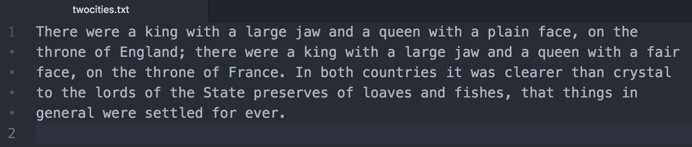
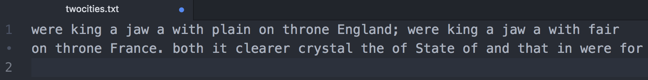
Programming Problem 2
071002
Create a text ﬁle and save it on your computer. Here is an example.
Write a C++ program that reads in the content of the ﬁle and then outputs only every second word on the screen. Your program should output the following for the given text ﬁle.

Slide 29
Programming Problem 3
071003
Write a program that will search a ﬁle of numbers of type int and write the largest and the smallest numbers to the end of that ﬁle. The ﬁle contains nothing but numbers of type int separated by spaces or line breaks.

Slide 30
Programming Problem 4
071004
Write a program that will read in a ﬁle containing nothing but numbers of type int separated by spaces or line breaks. Sort the numbers and write them into a new ﬁle.

Slide 31
STREAM Output Formatting

Slide 32
Stream Output Formatting
Sometimes you may want to have the output from your program to be displayed (on screen) or stored (in file) in a specific format
Floating-point numbers: 0.00001 or 1e-5? 15 or 15.000?
Formatted tabular output:
We may use the output manipulators to format the output. We've come across some examples:
endl, to move the insertion point to the beginning of the next line
setw, to set the width of the column for the next output value
Peter 30 130.5
John 6 129.3
Mary 18 34.5
How to set the width of each column?
How to set the column alignment?

Slide 33
Default floating-point notation
Example
Default to 6 significant digits
#include <iostream>
using namespace std;
int main()
{
double a = 1.2345678;
double b = 0.00012345678;
double c = 1234567.8;
double d = 0.000012345678;
cout << a << endl << b << endl << c << endl << d << endl;
return 0;
}
Screen output
1.23457
0.000123457
1.23456e+06
1.23457e-05
Lengthy numbers are written in scientific notation
default_float.cpp

Slide 34
showpoint Manipulator
Example
default is no decimal point if decimal value is 0
#include <iostream>
using namespace std;
int main()
{
double e = 12.0;
cout << e << endl;
cout << showpoint << e << endl;
return 0;
}
Screen output
12
12.0000
display decimal point with padding zeros with showpoint
can be unset with the noshowpoint manipulator
default_float.cpp

Slide 35
fixed / scientific Manipulators
fixed to write floating-point numbers as fixed decimal
scientific to output floating-point numbers in scientific notation
#include <iostream>
using namespace std;
int main()
{
double f = 0.135;
cout << f << endl;
cout << fixed << f << endl;
cout << scientific << f << endl;
cout.unsetf(ios_base::floatfield);
cout << f << endl;
return 0;
}
Screen output
default
0.135
0.135000
fixed
1.350000e-01
0.135
Scientific notation
default
manipulator_fixed.cpp

Slide 36
setprecision Manipulator
With the default floating-point notation, setprecision specifies the maximum number of meaningful digits before and after the decimal point.
#include <iostream>
#include <iomanip>
using namespace std;
int main()
{
double a = 1.2345678;
double b = 1234567.8;
cout << a << '\n' << b << "\n\n";
cout << setprecision(2);
cout << a << '\n' << b << '\n';
return 0;
}
Screen output
1.23457
1.23457e+006
1.2
1.2e+006
showing 2 significant digits with setprecision(2)
manipulator_setprecision.cpp

Slide 37
setprecision Manipulator
With the fixed or scientific notation, setprecision specifies the exact number of digits after the decimal point. By default, 6 decimal places are used.
#include <iostream>
#include <iomanip>
using namespace std;
int main()
{
double a = 1.2345678;
double b = 1234567.8;
cout << fixed << setprecision(2);
cout << a << '\n' << b << "\n\n";
cout << setprecision(8);
cout << a << '\n' << b << '\n';
return 0;
}
Screen output
showing 2 decimal places with setprecision(2)
1.23
1234567.80
1.23456780
1234567.80000000
Showing 8 decimal places with padding zeros at the end with setprecision(8)
Try using setprecision with scientific notation
manipulator_setprecision.cpp

Slide 38
setw Manipulator
Use setw to output a string or a number in a specific number of columns (the output is right-justified).
#include <iostream>
#include <iomanip>
using namespace std;
int main()
{
int x = 12; string a = "Hello";
double b = 34.567;
cout << fixed << setprecision(2); cout << "12345678901234567890\n";
cout << setw(5) << x << setw(8) << a;
cout << setw(6) << b << endl;
return 0;
}
Screen output
12345678901234567890
12 Hello 34.57
5 cols
8 cols
6 cols
For those manipulators that accept parameters such as setw(x), include the <iomanip> header; otherwise for those manipulator without parameters such as fixed, include the <iostream> header
manipulator_setw.cpp

Slide 39
setfill Manipulator
With setw, if the specified number of columns > the required number of columns, the unused columns are filled with spaces. We may use setfill to fill the unused columns with other characters.
#include <iostream>
#include <iomanip>
using namespace std;
int main()
{
int x = 12;
string a = "Hello";
double b = 34.567;
cout << fixed << setprecision(2);
cout << "12345678901234567890\n";
cout << setfill('*');
cout << setw(5) << x << setw(8) << a;
cout << setw(6) << b << endl;
return 0;
}
Screen output
12345678901234567890
***12***Hello*34.57
manipulator_setw.cpp

Slide 40
left / right Manipulators
With setw, the default output is right-justified within a column. Use the left and right manipulators to set the output to be left-justified or right-justified, respectively.
…
cout << "12345678901234567890\n"; cout << setfill('-');
cout << left;
cout << setw(5) << x << setw(8) << a;
cout << setw(6) << b << endl;
cout << right;
cout << setw(5) << x << setw(8) << a;
cout << setw(6) << b << endl;
…
Screen output
12345678901234567890
12---Hello---34.57-
---12---Hello-34.57
left and right are defined in <iostream>
manipulator_setw.cpp

Slide 41
Further References on File I/O
C++ Language Tutorial: Input/Output with files http://www.cplusplus.com/doc/tutorial/files/
C++ Library Reference: ifstream class http://www.cplusplus.com/reference/fstream/ifstream/
C++ Library Reference: istringstream class http://www.cplusplus.com/reference/sstream/istringstream/
C++ Library Reference: ofstream class http://www.cplusplus.com/reference/fstream/ofstream/
C++ Library Reference: ofstream class http://www.cplusplus.com/reference/library/manipulators/

